Slide 1

AniResQ
A Community-Driven Animal Rescue
& Adoption Network
REVIEW–II
TEAM MEMBERS
Vigneshwar M (99240040338)
Judson Pushparaj C (99240040056)
Venu Madhav S (99240041284)
Karthikraja K (99240040071)
Project Guide: Mrs.Sujitha
Notes:
Opening (25 seconds): AniResQ is a community-driven web platform intended to connect citizens, volunteers, shelters and veterinarians across the rescue-to-adoption lifecycle. Introduce the four team members exactly as shown. This is Review-I: emphasize the identified problem, surveyed work, proposed method and reported project progress.
Rubric mapping: problem statement 10 marks (slides 3–4); literature survey 10 marks (slides 5–6); proposed methodology 20 marks (slides 7–12); certification progress 10 marks (slide 13).
The college banner is reused from the supplied university-style reference. The guide field is intentionally blank because no AniResQ guide name was supplied.

Slide 2
Introduction:
AniResQ is a community-driven digital ecosystem that connects citizens, volunteers, animal shelters and veterinarians to coordinate animal rescue, treatment and adoption.
Citizens
Volunteers
Animal Shelters
Veterinarians
Report and adopt
Respond and rescue
Review and coordinate
Treat and document
AniResQ Platform
NGO
protect, rescue Animal
The platform enables:
Emergency reporting • Volunteer coordination • Adoption • Shelter management
Notes:
Talk track: A citizen creates an emergency report; a shelter reviews it; a volunteer carries out the rescue; a veterinarian records treatment. When an animal becomes suitable for adoption, the shelter publishes its profile. All roles use the same case context.
Viva prompt: Why four user roles? Their responsibilities differ. Separating roles supports clear assignment and least-privilege access. The diagram describes the proposed ecosystem, not measured adoption or rescue outcomes.

Slide 3
Problem Statement:
Animal rescue efforts often rely on scattered posts, group messages and phone calls. This makes it difficult to identify a responsible responder and follow a case from the initial report to treatment and adoption.
Current challenges include:
•
No centralized rescue platform for local coordination
•
Delayed emergency response
•
Fragmented WhatsApp and Facebook communication
•
Lack of volunteer coordination
•
Poor visibility of animals available for adoption
Notes:
Problem scope: These are the project team’s stated challenges in fragmented local rescue coordination, not a claim that no animal rescue platforms exist worldwide. Validate them through stakeholder interviews and case observations before making population-wide claims.
Viva prompt: What is the central problem? Loss of continuity from a citizen report to assignment, treatment and adoption. AniResQ proposes a shared record with explicit responsibility and status. Do not claim a measured response-time improvement before collecting a baseline.

Slide 4
Existing System and Limitations:
Existing System | Limitation | Impact
Facebook Groups | Unorganized | Reports are difficult to prioritize.
WhatsApp Groups | No Tracking | Case updates become difficult to follow.
Phone Calls | Delayed Response | Follow-up depends on availability.
NGOs | Limited Reach | Capacity and geography constrain help.
AniResQ provides a shared case record, an assigned responder and visible progress through the rescue lifecycle.
Notes:
Explain that social groups and calls can be valuable for outreach, but they do not inherently create the structured workflow required by this project. “NGOs” refers to independent operations with limited shared coordination, not a criticism of their work.
Viva prompt: Why build a web application if WhatsApp is widely used? The application can maintain state, ownership, role permissions and an adoption record that remain difficult to enforce consistently in informal group communication.

Slide 5
Literature Survey:
S.No | Journal / Paper | Authors | Year | Tools / Technologies | Advantages | Disadvantages
1 | Increasing Adoption Rates at Animal Shelters: A Two-Phase Approach to Predict Length of Stay and Optimal Shelter Allocation | Janae Bradley, Suchithra Rajendran | 2021 | Machine Learning, Logistic Regression, ANN, Gradient Boosting, Random Forest | • Predicts animal shelter length of stay • Helps improve shelter allocation • Uses multiple ML models | • Mainly focuses on shelter data • Requires historical data
2 | Animal Ranger Website Design: Animal Adoption Platform | Ferdianto, Witarsyah, William Theodore, Apollos Avrialdo, Faiq Naufal | 2023 | Web Application, UML, Database | • Connects animal shelters and animal lovers • Supports animal rescue and adoption • Improves availability of animal information | • Mainly focuses on website-based adoption • Limited advanced recommendation features
3 | A Content-Based Recommendation System for Animal Adoption Using the Weighted Cosine Technique | M. C. Santos. | 2023 | Content-Based Filtering, Weighted Cosine Similarity | • Matches animals with adopter preferences • Helps users find suitable animals • Provides personalized recommendations | • Depends on available animal/user information • Mainly focuses on recommendation
4 | Efficient Framework for Pet Adoption and Recommendation System | Ipshit Haste, Jagdish Pimple, Tushar Thakare, Krutika Gadigone. | 2025 | Centralized Database, Search Filters, Recommendation, Messaging | • Centralizes adoption information • Provides search and comparison features • Supports communication between users | • Mainly focused on adoption • Limited rescue coordination
5 | Be My Home in Smart Cities: A Mobile Application for Stray Animal Tracking, Adoption and Shelter Management | Hacer Sueda Efe, Gizem Yildiz, Önder Yakut | 2025 | Android, Java, Firebase, GPS/Location Services | • Tracks stray animals • Supports adoption and shelter management • Includes health/vaccination tracking • Supports location-based information | • Requires continuous data updates • Depends on active participation from users/shelters
Notes:
Present the evidence without overclaiming novelty.
[1] Bradley, J. and Rajendran, S. (2021). Increasing adoption rates at animal shelters. BMC Veterinary Research, 17, 70. https://doi.org/10.1186/s12917-020-02728-2 . Compares logistic regression, neural networks, gradient boosting and random forests for length-of-stay prediction; proposes a goal-programming relocation stage. Authors identify limited data and missing behavioral variables.
[2] Theodore, W.; Avrialdo, A.; Naufal, F.; Ferdianto; Witarsjah (2023). Animal Ranger Website Design: Animal Adoption Platform. SEEIJ 7(2), 56–68. https://doi.org/10.21512/seeij.v7i2.10497 . The PDF lists this author order; journal metadata lists Ferdianto first. The design already combines rescue, adoption, location-based reports and user-profile verification. React, Flask, MongoDB and Cloudinary are described. Tracking is named as future work.
[3] Santos, M. C.; Santos, L. L. S.; Santos, V. H. B.; Brandão, G. S.; Durão, F. A. (2024). Content-based animal-adoption recommendations using weighted cosine. Texto Livre 17. https://doi.org/10.1590/1983-3652.2024.42708 . The method weights adopter preferences and reports improved recommendation precision. Absence of rescue dispatch is a scope comparison by this team, not a limitation quoted from the authors.
[4] Haste, I., et al. (2025). Efficient Framework for Pet Adoption and Recommendation System. IEEE SCEECS, pp. 1–4. https://doi.org/10.1109/SCEECS64059.2025.10941208 . The IEEE publisher abstract describes breed/age and other search filters, comparison tools, direct messaging, and guidance for new pet owners. Advantages shown are the intended capabilities, not measured outcomes. Rescue dispatch is not discussed in the abstract; the limitation cell is an abstract-level scope comparison, not a claim about every feature of the full paper. The full text was not accessible; implementation stack and numerical evaluation are not verified. Source: https://ieeexplore.ieee.org/document/10941208/ .
Viva prompt: Which study is closest to AniResQ? Animal Ranger; the proposed contribution must therefore focus on the detailed volunteer, case-status and veterinary-handoff workflow rather than claiming to be the first rescue/adoption ecosystem.

Slide 6
Research Gap:
Prior systems emphasize adoption, shelter operations or recommendation. AniResQ proposes explicit coordination across the full rescue-to-adoption lifecycle.
Common Focus in Existing Approaches | Proposed AniResQ Scope
Adoption-only portals | Rescue management and adoption
Shelter-management-only tools | A shared citizen–shelter ecosystem
Recommendation-only models | Case progression and veterinary handoff
Limited rescue coordination | Volunteer assignment and GPS reporting
Proposed contribution: clear ownership and traceable rescue-to-adoption case status.
Notes:
The left column describes narrow-scope categories, not a feature audit of every paper. Animal Ranger already includes both rescue and adoption and uses location information; acknowledge this. AniResQ’s defensible proposed differentiation is explicit volunteer dispatch, state transitions and veterinary handoff under separate roles. Implementation and user evaluation are still needed to establish practical benefit.
Source: Animal Ranger, DOI 10.21512/seeij.v7i2.10497. Literature synthesis is an inference from the reviewed scopes, not proof that no alternative system has the same features.
Viva prompt: What is new? A specific coordinated workflow and locally usable implementation; avoid a “first-ever” claim.

Slide 7
Objectives:
•
Create a centralized animal rescue network.
•
Enable faster emergency response through location-based reporting.
•
Improve volunteer coordination and case ownership.
•
Support animal adoption through verified profiles and applications.
•
Connect shelters, citizens and veterinarians.
•
Improve animal welfare outcomes through continuity of care.
Notes:
Describe objectives as intended improvements. Quantify them only after baseline data and a pilot. Potential measures: report-to-verification time, verification-to-assignment time, proportion of assigned cases completed, applications resulting in approved adoptions, and unauthorized API requests rejected.
Viva prompt: How will success be measured? Compare agreed process metrics before and after a pilot and run functional/access-control checks. No benchmark values or improvement percentages have been supplied, so none are claimed.

Slide 8
Proposed Methodology:
Intake and Data Processing
1
2
3
4
5
Citizen
Reports
Animal
GPS Location
Captured
FastAPI
Backend
Firebase
Database
Start a case
Describe the need
Confirm location
Validate request
Store in Firestore
10
9
8
7
6
Adoption
Module
Animal
Treatment
Rescue
Operation
Volunteer
Assignment
Shelter
Review
List when suitable
Record care
Rescue the animal
Assign a responder
Verify the report
Shelter Coordination, Treatment and Adoption
Notes:
Read steps 1–5 left to right, then 6–10 right to left following the arrows. Firestore holds the case; the shelter reviews it through the web application and FastAPI, not by editing the database directly. GPS means a location attached to a report; live vehicle tracking is not claimed. If location permission is denied or inaccurate, support user confirmation/manual coordinates. After treatment, only animals assessed as suitable should enter adoption.
Each transition should record actor, status and timestamp. Shelter coordination remains a human decision in the current design; AI prioritization is future work.
Viva prompt: Why store first and review later? Persistence creates a trackable case ID, allowing review, assignment and care updates to reference the same case.
Browser location guidance: https://developer.mozilla.org/en-US/docs/Web/API/Geolocation_API .

Slide 9
System Architecture:
Users
Frontend
Backend
Database
Citizen
Server SDK
Read / Write
Web Application
HTTPS
+ JWT
FastAPI
Firebase
Firestore
Volunteer
JWT issue / verify
JavaScript
Vite
Signature • Expiry • Roles
Shelter
Rescue and Assignment
Treatment and Adoption
Users • Cases
Assignments • Animals
Treatment • Applications
Veterinarian
GPS / Location
NGO
JSON
Records
Notes:
Proposed request flow: a user signs in through the React client; FastAPI validates credentials and issues an expiring signed JWT. Subsequent HTTPS requests present the token. The API verifies the signature, expiry and relevant role/ownership before processing a request. Successful reads and writes go through the server SDK to Firestore. JSON responses update the client. JWT is a token format, not the database or a complete authorization system.
Security design: scope citizens to their own reports/applications; volunteers to assigned cases; shelters to case coordination; veterinarians to treatment updates. Derive authorization from trusted server-side role data. Store password hashes rather than plaintext; keep signing keys/service credentials on the server. For this server-access design, Firestore server libraries bypass Firestore Security Rules, so authorization must be enforced in FastAPI with appropriate service-account IAM. The browser has no direct database path in this diagram.
Technology claims are design guidance, not proof that controls were audited.
Sources: https://fastapi.tiangolo.com/tutorial/security/oauth2-jwt/ ; https://firebase.google.com/docs/firestore/security/rules-conditions .
Viva prompt: Is JWT encrypted? A typical signed JWT is readable; do not put passwords or sensitive personal details in its payload.

Slide 10
Emergency Rescue Workflow:
1
2
3
4
Emergency
Detected
Citizen
Reports
Shelter
Verification
Volunteer
Dispatch
7
6
5
Case Closed
Treatment
Rescue Action
Outcome recorded
and linked to the
animal profile.
Incomplete report → request clarification. Volunteer unavailable → reassign the case.
Notes:
The main flow shows the successful rescue path. Shelter verification checks report validity and available capacity. If information is incomplete, request clarification; if no volunteer accepts, return the case to the assignment queue. The workflow is conceptual and does not show deployment data.
Rescue case closure records the outcome. Closing a rescue case is distinct from adopting an animal; adoption continues through the linked animal record when appropriate.
Viva prompt: What if the first volunteer is unavailable? Keep the case pending and reassign it with a recorded owner/status change. Retain timestamps to avoid duplicate or abandoned assignments.

Slide 11
Pet Adoption Workflow:
1
2
3
Animal Available
Animal Listed
User Application
Shelter confirms readiness
Profile and health details
Adopter submits interest
6
5
4
Successful Adoption
Approval
Verification
Handover completed
Shelter decision
Suitability and commitment
Animal availability is updated after the approved adoption is completed.
Notes:
Eligibility precedes listing: the shelter confirms that the animal is available and suitable for adoption. Profiles should include relevant characteristics and health information. Citizens apply, the shelter assesses suitability, and approved applicants complete handover. The diagram shows the successful path; rejected or incomplete applications should remain distinguishable from approved ones, with only the minimum necessary applicant information visible to authorized staff.
Viva prompt: Does approval automatically mark the animal adopted? Prefer separate approved and completed/handover states; update availability only when adoption is finalized. Recommendations and AI matching are not claimed as current functionality.

Slide 12
Technology Stack:
Frontend:
JavaScript, Vite
Backend:
FastAPI
Database:
Supabase PostgreSQL (Postgres)
Authentication:
Supabase
Version Control:
GitHub
Notes:
Explain the purpose of each technology rather than listing names. React builds UI components. Vite provides the development/build tooling. Tailwind handles styling. FastAPI exposes Python APIs and can validate structured input. Firestore is the persistent database. JWTs represent authenticated sessions but authorization is enforced by the server. Git is the version-control system; GitHub hosts the repository and collaboration workflow.
Viva prompt: Why not let the browser write all data directly? This proposed architecture centralizes workflow and permission decisions in the API. This trade-off should be weighed against the extra backend dependency. No paid product tier or production scalability guarantee is asserted.

Slide 13
Current Progress & Certification:
Project Progress: 70%
Team-reported completion
Literature Survey
Requirement Analysis
UI Design
Backend Development
Authentication
Firebase Integration
Testing
Notes:
The 80% value and seven checked milestones are exactly the team-reported progress provided in the brief. They have not been independently verified against source code, tests or a demo. Do not interpret the seven checks as a mathematical derivation of 80%. Testing may refer to tests completed for the current iteration; final end-to-end validation and review evidence can still remain. Confirm this interpretation with the actual project record before presenting.
Certificates are placeholders, not claims that any course has been completed. Replace each with the actual learner name, course name, completion date, credential identifier and certificate image or URL. Avoid implying certification completion while evidence is absent.
Viva prompt: What evidence supports progress? Demonstrate the working UI, authentication flow, database writes and a test log. For the certification rubric, present the actual provider certificates.

Slide 14
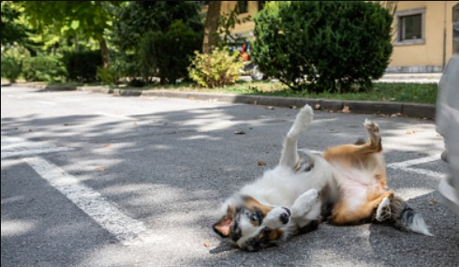
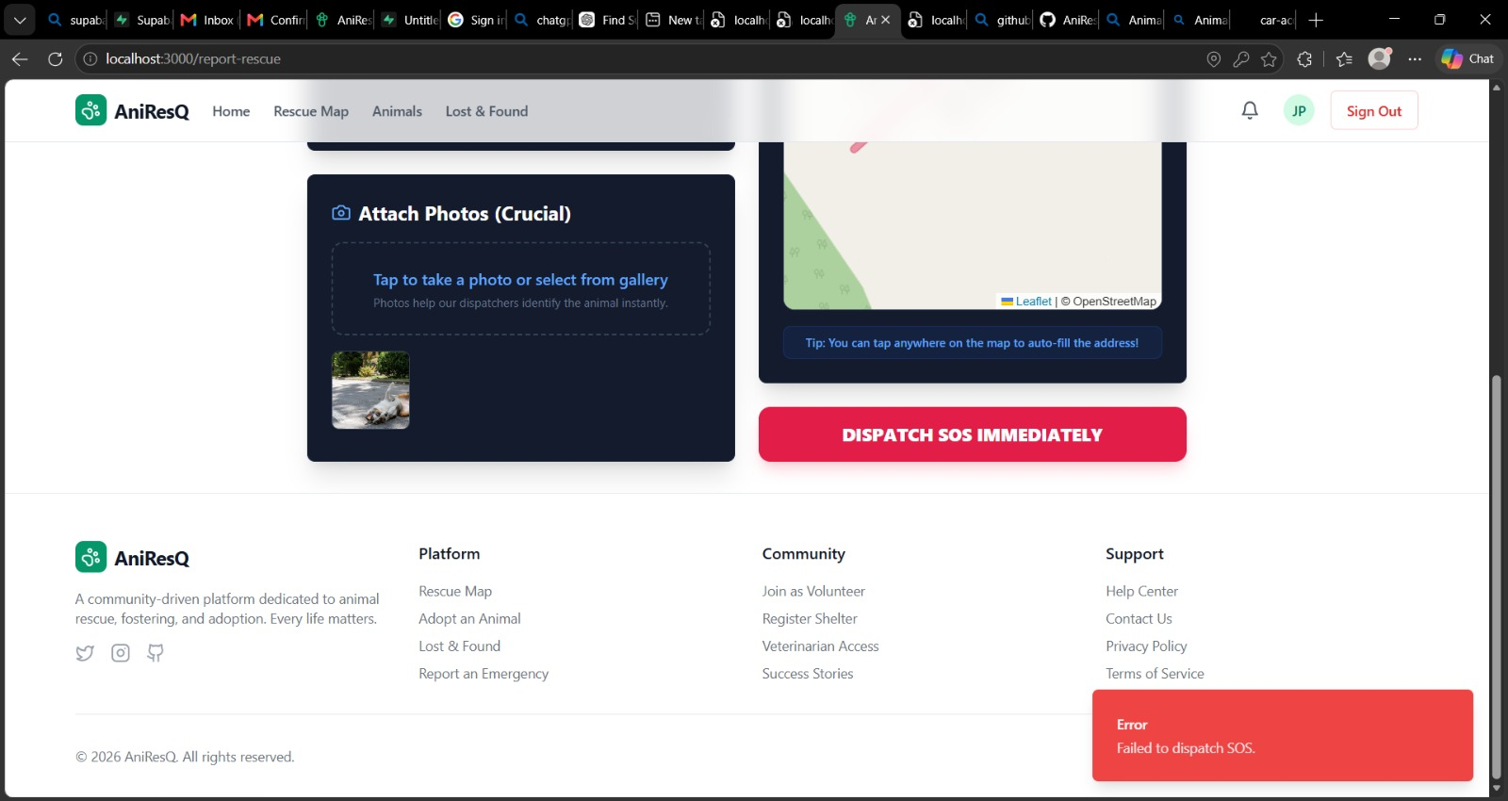
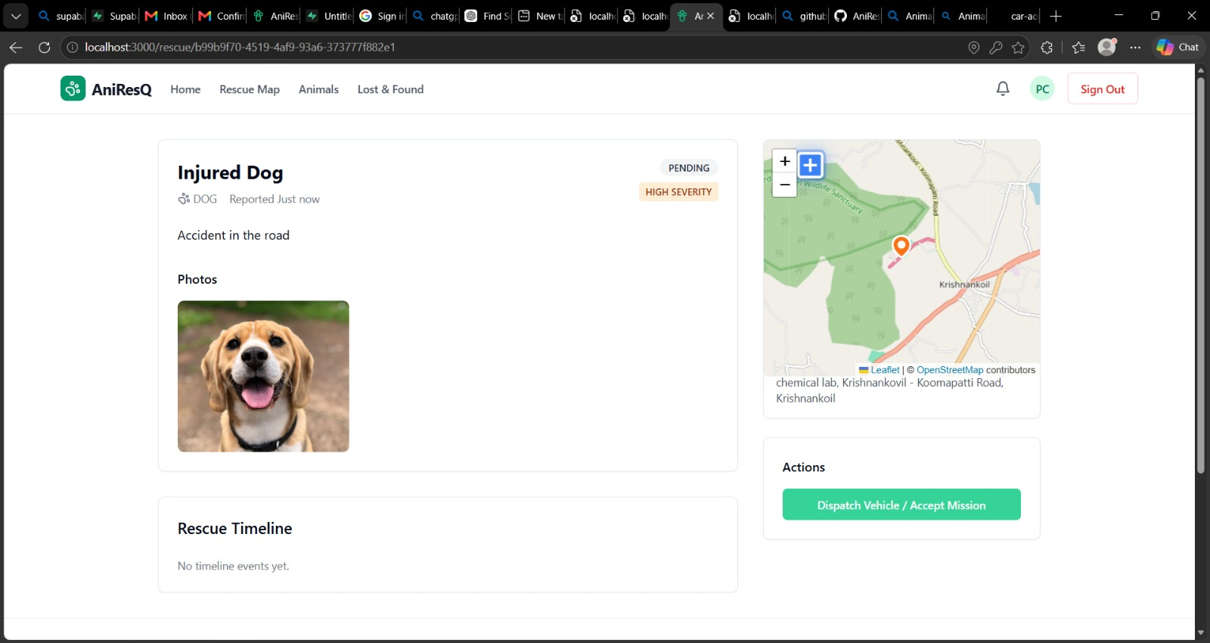
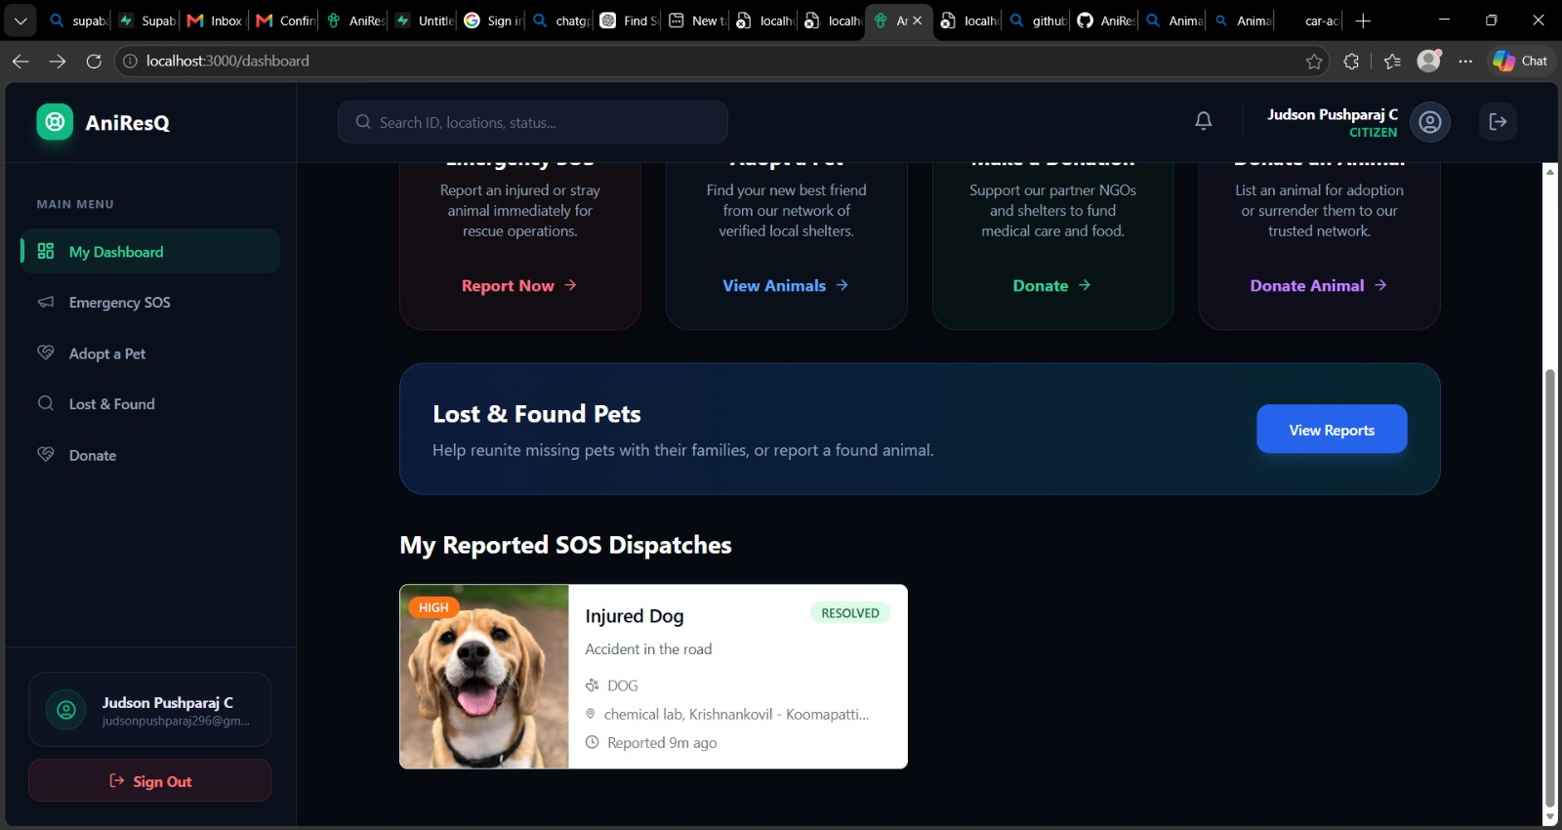
OUTPUT:

Slide 15
Conclusion & Future Work:
AniResQ brings animal rescue, volunteer coordination, shelter management and pet adoption into one centralized ecosystem. Its proposed workflow maintains continuity from the first report to rescue, treatment and adoption.
Future Work:
•
Mobile Application
•
AI-Based Rescue Prioritization
•
Veterinary Appointment Booking
•
Real-Time Notifications
•
Analytics Dashboard
THANK YOU
Notes:
Close with the integrated workflow: rescue reporting, volunteer coordination, shelter management and adoption can share one case context. These are proposed/implemented capabilities reported by the team; improved welfare and response time still require evaluation.
Future work is explicitly separate from current scope: mobile application, AI prioritization with human oversight, appointment booking, real-time notifications and an analytics dashboard. Prioritize reliable case workflows and validation before adding advanced features.
Possible viva question: What is the next practical step? Complete an end-to-end demonstration, validate permissions and state transitions, and collect pilot feedback from shelters and volunteers.

